Slide 1
gig tickets app
A web app providing tickets for gigs.

Slide 2
Key stakeholders/stakeholder management plan
Project Manager
Oversees the development of the app and co-ordinates the teams involved.
Development team
Software Engineers
Front-end Designer – Responsible for the overall look of the app.
Front-end Developer – Creates the app using HTML etc according to the Designer’s specs.
Back-end Developer – responsible for the database, APIs etc.
Quality Assurance
Test Engineer
Ensure the features work correctly.
Ensure the user journey is clear.
Customers/Users
Satisfaction – does the product meet their needs.
Quality – is the app user friendly and the performance reliable.
Event Organisers
Success of the event
Ease of use – Require a user-friendly and efficient platform for listing events, eg; setting ticket types/prices etc.

Slide 3
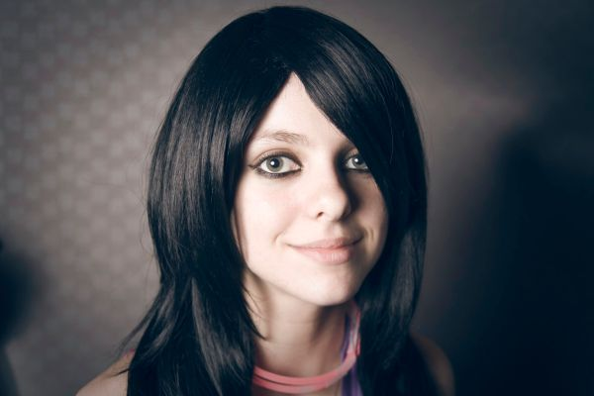
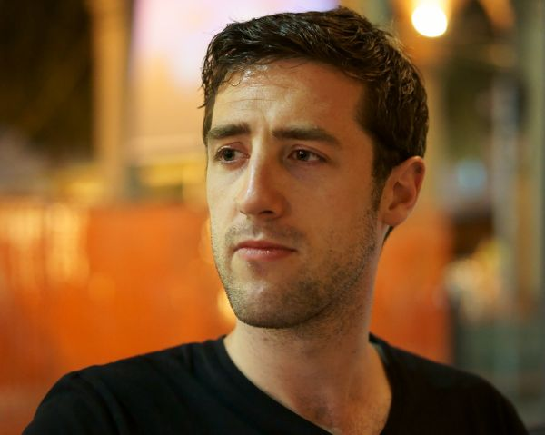
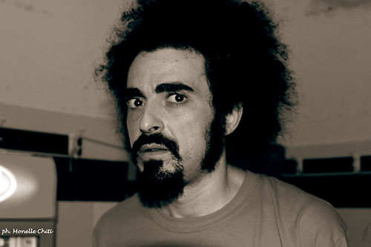
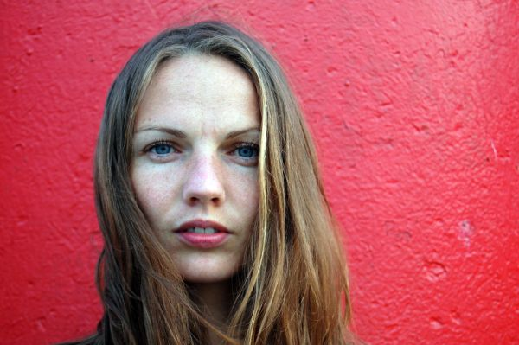
Market research 50 event/gig attendees were surveyed to discover what they would require in a ticket selling app.
“I don’t like to travel so would like to be able to see what gigs are happening close by.”
“I have specific taste in music, so would like to be able to search for tickets by genre.”
“I’m always losing things. The option of storing tickets electronically would be great.”
“I would like to receive notifications when gigs are announced by artists I like”
Barbara
Keith
Dave
Beryll

Slide 4
FURTHER SUGGESTED REQUIREMENTS GATHERED FROM THE SURVEY
“I would like to be able to select my seat (if seating available).”
“App should be easy to navigate and not too ‘busy’.”
“Suggested local accommodation would be good, so If I book a gig in Chester, I’d like to see a list of local Chester B&Bs.”
“I’d like to see all gigs being shown at specific venues.”
If I’m travelling abroad, it would be great to be able to search for local shows.”
“Reviews of past performances would be useful to help me decide on whether to see an artist or not.”
“I would love to be able to attend a gig ‘virtually’ if I miss out on purchasing a ticket.

Slide 5
MoSCoW PRIORITISATION
Must have
Should have
User registration
User profile
Event listings
Booking capabilities
Payment processing
Search/filter by location
Search/filter by genre
Search/filter by venue
Search/filter by date
Could have
Won’t have
Reviews of past performances
Event reminders
Notifications when new events are announced
Digital Ticket storage
Ability to search/filter outside the UK
Booking for local accommodation.
VR/Streaming capabilities.

Slide 6
SOFTWARE REQUIREMENTS OVERVIEW
User registration & login
Event listings
Search functionality that works using various inputs (venue, date etc)
Ability to book tickets
Payment processing capabilities
Digital ticket storage

Slide 7
SOFTWARE: Functional Non-functional
Performance (usability etc):
App should load events quickly.
Payment processing should be secure and efficient.
Quick responses to user interactions.
Interface should be user-friendly.
App should be able to handle increased traffic during peak ticket sale periods.
Security:
User data must be stored securely.
Payment processing must comply with industry standard protocols.
Reliability:
App should be available and operational 24/7, with minimal downtime
Back-up and disaster recovery processes must be in place to prevent data loss
User registration & login
Event listings
Ticket booking
Payment processing
Seat selection
Order confirmation
User profile
Search functionality
Digital ticket storage
Reviews and ratings

Slide 8
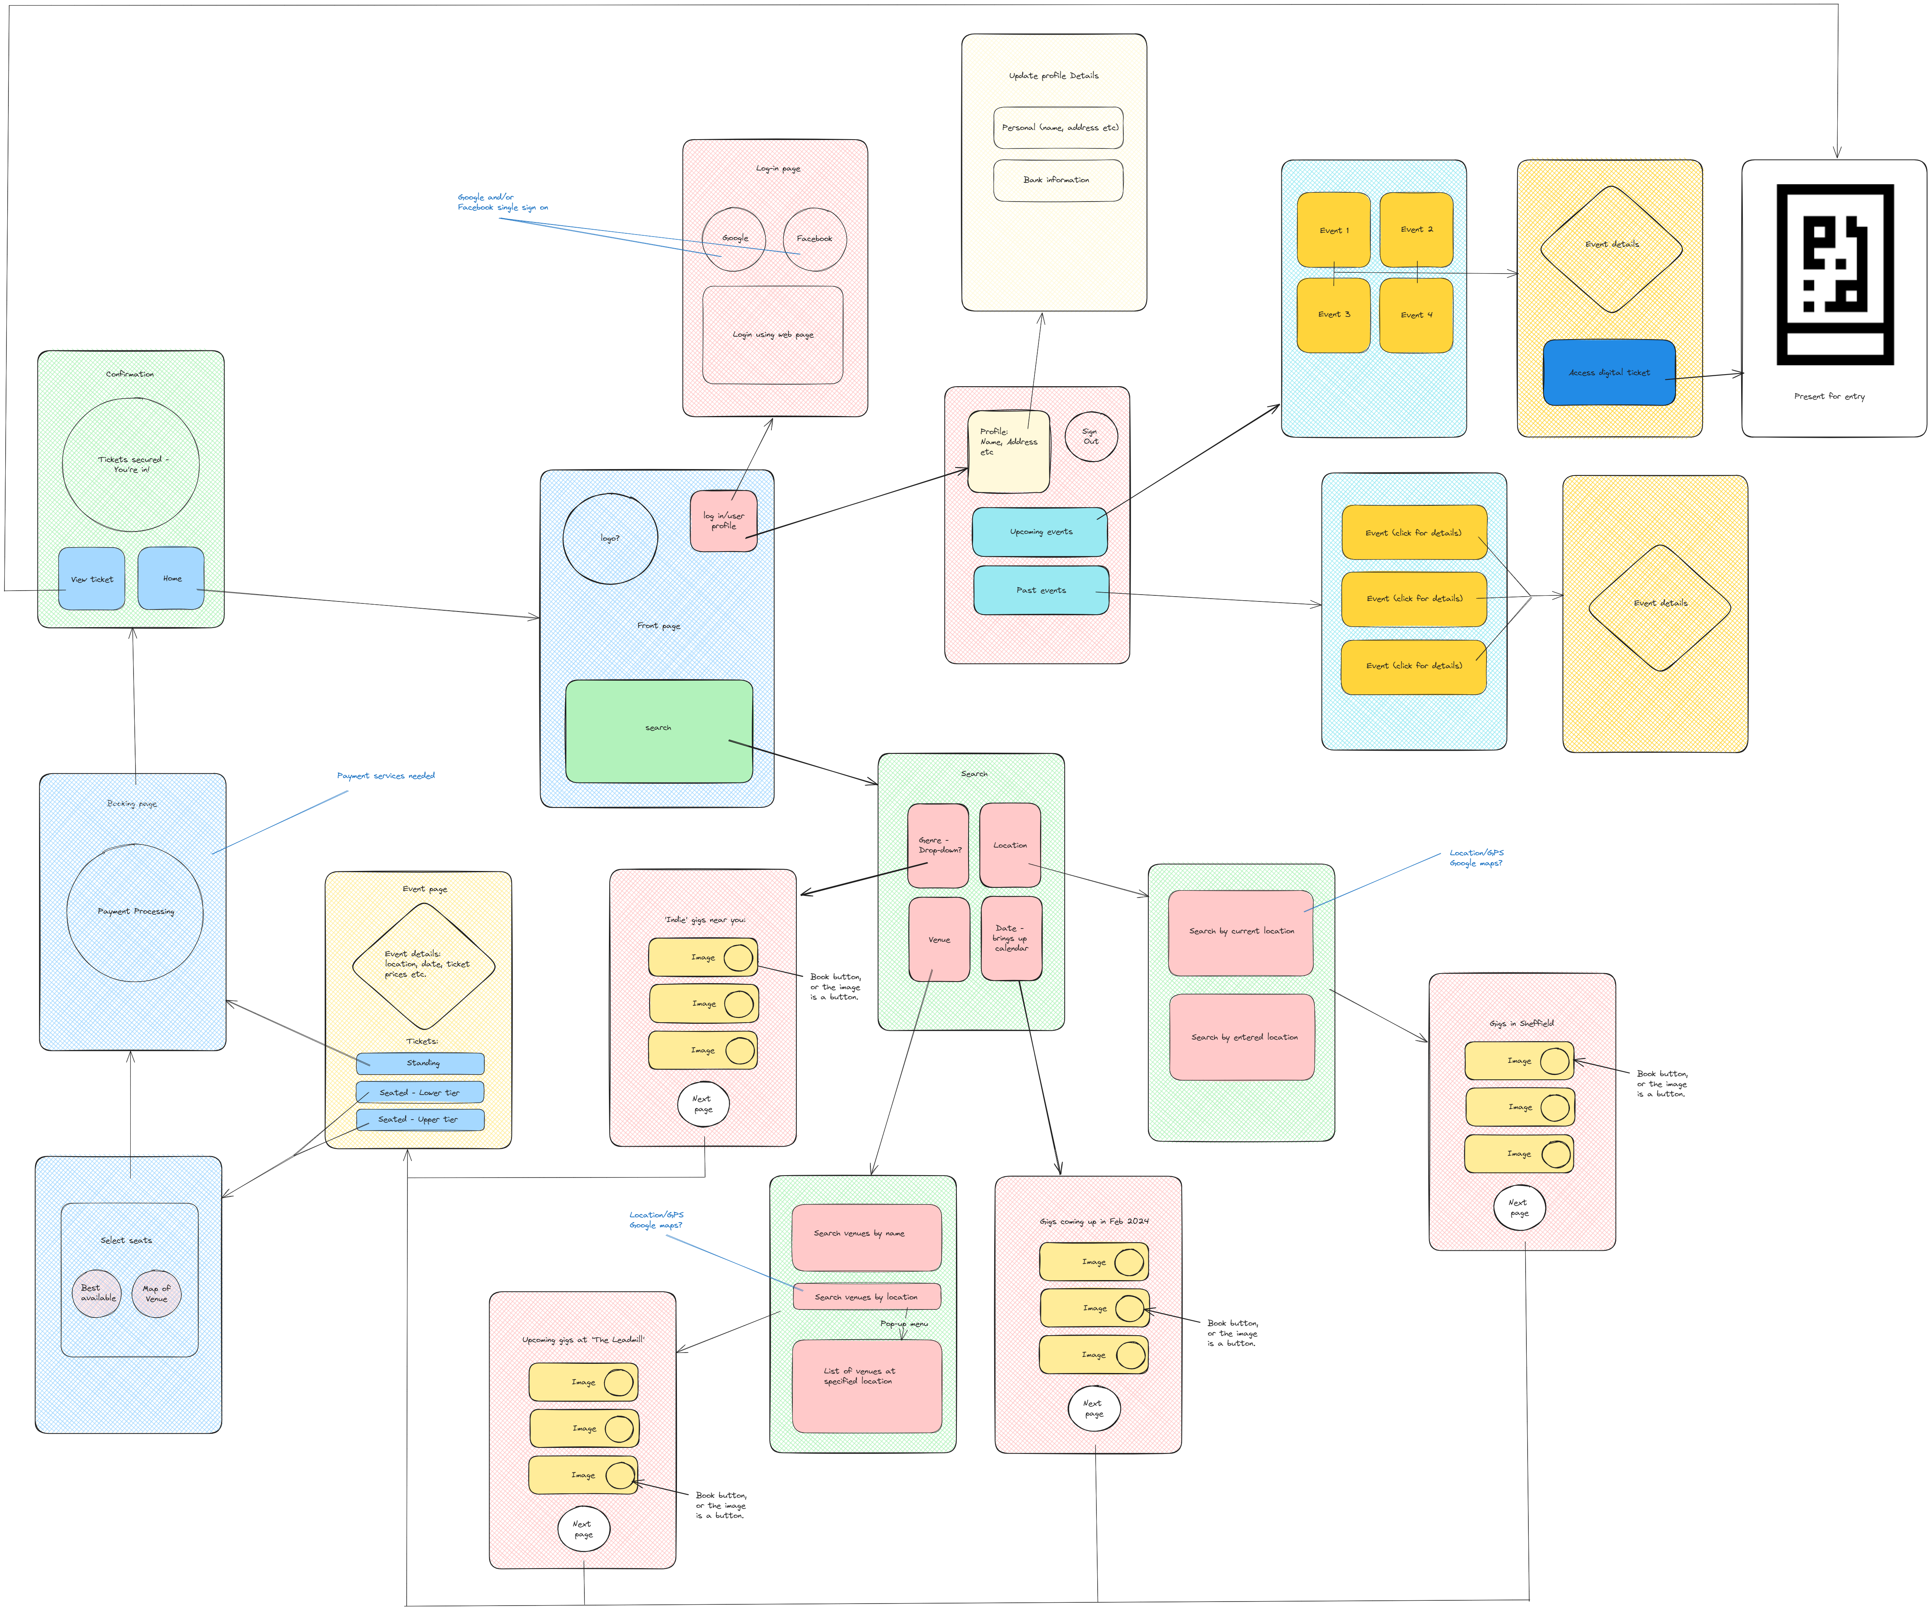
USER INTERFACE WIREFRAME

Slide 9
DEPENDENCIES
Third Party Services:
Payment gateways, eg PayPal
External databases for data storage
Location services, GPS, Google Maps
Regulatory
Compliance:
App must comply with data protection and privacy laws.
Event
Sources:
Dependency on event organisers and venues to provide accurate event information.

Slide 10
DEVELOPMENT APPROACH
Promotes iterative development with a focus on customer collaboration.
Allows rapid delivery of features
Adapts when requirements change.
Agile:

Slide 11
DEVELOPMENT PROCESS
Project initialisation:
User Story: As a project manager, I want to create a project plan and allocate resources for the ticket-selling app development.
User Management:
User Story: As a user, I want to register with my email and password.
User Story: As a user, I want to log in securely.
User Story: As a user, I want to reset my password if I forget it.
User Story: As an admin, I want to manage user accounts and permissions.
Event Listings:
User Story: As a user, I want to view a list of available events with details.
User Story: As a user, I want to filter and search for events by date, location, venue and genre.
User Story: As a user, I want to see event images and descriptions.
User Story: As an admin, I want to add, edit, or remove events.
Ticket Booking:
User Story: As a user, I want to select an event and purchase tickets securely.
User Story: As a user, I want to see ticket availability and pricing.
User Story: As a user, I want to choose specific seats (if applicable).
User Story: As a user, I want to receive a confirmation of my ticket purchase.
Payment Processing:
User Story: As a user, I want to pay for tickets using a credit card securely.
User Story: As an admin, I want to integrate payment gateways such as PayPal.

Slide 12
DEVELOPMENT PROCESS
User Profile:
User Story: As a user, I want to view and edit my profile information.
User Story: As a user, I want to see my transaction history and ticket purchases.
User Story: As an admin, I want to manage user accounts and access
Event Reminders
User Story: As a user, I want to set event reminders through push notifications or email.
Performance Optimisation:
User Story: As a developer, I want to optimise app performance for fast loading and responsiveness.
Security and Compliance:
User Story: As a developer, I want to implement secure authentication and data protection.
User Story: As a compliance officer, I want to ensure the app complies with data protection regulations.
Quality Assurance and Testing:
User Story: As a tester, I want to create test cases for user scenarios and perform thorough testing.
Deployment:
User Story: As a system administrator, I want to set up staging and production environments.
User Story: As a developer, I want to deploy the app to a cloud platform (e.g., AWS, Azure).

Slide 13
EPIC TASKS – initial estimates in Story Points (SP)
User Management
Event Management
Create user registration & login system
Develop user profile management features
3-5 SP
Create system for adding, removing & editing events.
Create templates with standard details, eg location, date etc
Set up event categories, eg genre
8-13 SP
5-8 SP
5-8 SP
3-5 SP
Event listings search/filter
Ticket Booking
Create user-friendly interface to display event listings
Implement search & filter capabilities
Include event images, ratings and reviews
5-8 SP
Develop the booking process, inc seat selection (if applicable)
Implement secure payment processing
Generate booking confirmation
5-8 SP
5-8 SP
8-13 SP
3-5 SP
3-5 SP

Slide 14
GANTT CHART (Story points converted to hours for the purposes of this presentation – 1 SP = 2 hrs)

